Slide 1
Pseudo-Inverses, Matrix Sizes, & Condition Numbers

Slide 2
This project was made up entirely just to see what happened.

Slide 3
Background

Slide 4



$$A^{−1}≈v{D_{0}}^{−1}u^{T}$$
Computing Pseudo Inverse
$$A=uΣv^{T}$$
Where A has a Singular Value Decomposition:
$${D_{0}}^{−1}=\left\{\begin{aligned}\frac{1}{σ_{i}} if{ σ}_{i}>ε \\ 0 otherwise\end{aligned} \right.$$
Where:

Slide 5
But How good is it?
Let’s compare with NumPy…

Slide 6

Let’s define our error as:
$$Error:= {\left\|v{D_{0}}^{−1}u^{T}−I\right\|}_{2}$$

Slide 7


Custom SVD vs Numpy Pseudo Inverse
$$A=\left[\begin{matrix}665 & 666 \\ 666 & 667\end{matrix}\right]$$
Condition(A) $≈$ 1774225.9998
Error: 0.001055447
Numpy Error: 0.000000003

Slide 8
Fairly Decent…
What happens if we increase the size of the matrix?

Slide 9
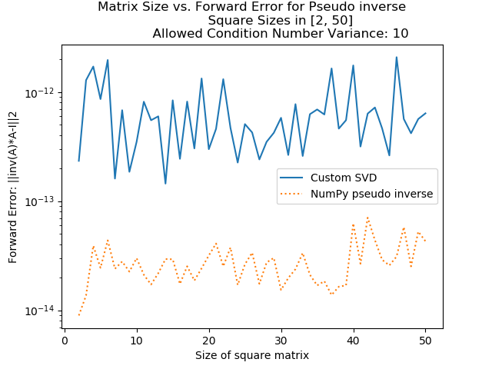
Matrix Size vs Error

Slide 10
Condition Number?

Slide 11
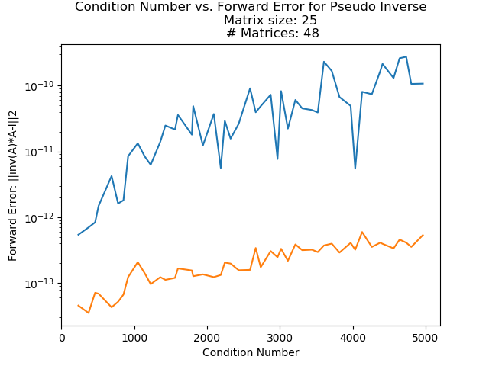
Matrix Condition Number vs Error

Slide 12
Is the size of the matrix completely unrelated?

Slide 13
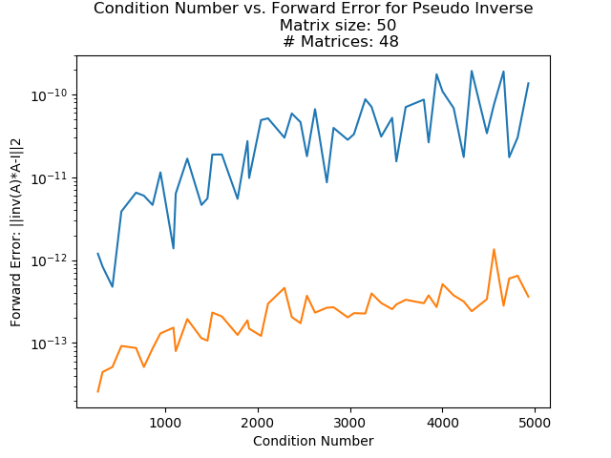
Matrix Condition Number vs Error Round 2

Slide 14
Why is this important?

